Slide 1
Chapter 2 Signals and Signal Space
Instructor: Dr. Masoumeh Kalantari
University of Central Florida

Slide 2
Signals and Systems
Signal: anything that conveys some information
Signals are a set of information (data)
Signals are a function of one or more variables. In this class we only work with signals that are a function of time
Voltage across a resistor
TV signal
Telephone signal
System: A system is an entity that takes signals as inputs and produces signals as outputs
system
g(t)
f(t)
Notes:
A system gets a function and modify it and generates another function

Slide 3
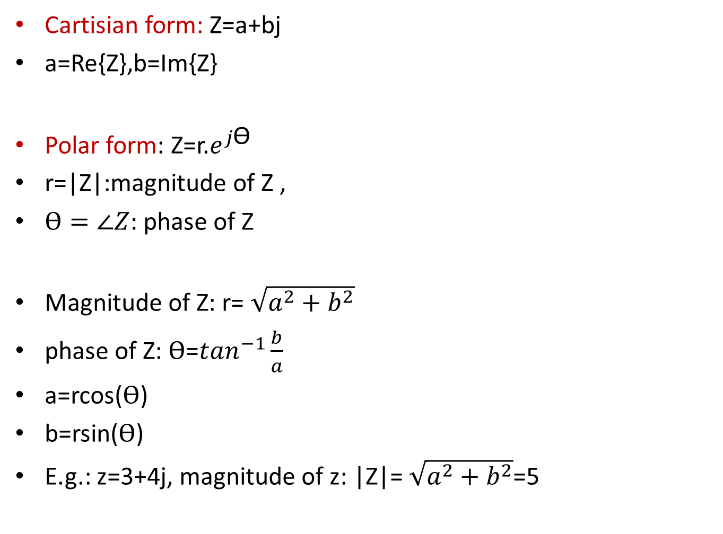
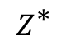
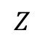
Overview on complex numbers
Cartisian form: Z=a+bj
a=Re{Z},b=Im{Z}
Polar form: Z=r.$e^{j\text{Ɵ }}$
r=|Z|:magnitude of Z ,
$ϴ=∠Z:$ phase of Z
Magnitude of Z: r= $\sqrt{a^{2}+b^{2}}$
phase of Z: $ϴ$=$\tan^{−1}\frac{b}{a}$
a=rcos($ϴ$)
b=rsin($ϴ$)
E.g.: z=3+4j, magnitude of z: |Z|= $\sqrt{a^{2}+b^{2}}$=5
Imaginary
b
$$Z$$
r
Ɵ
a
Real
$$Z^{\text{∗} }$$

Slide 4
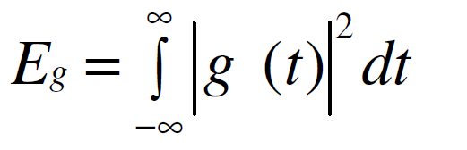
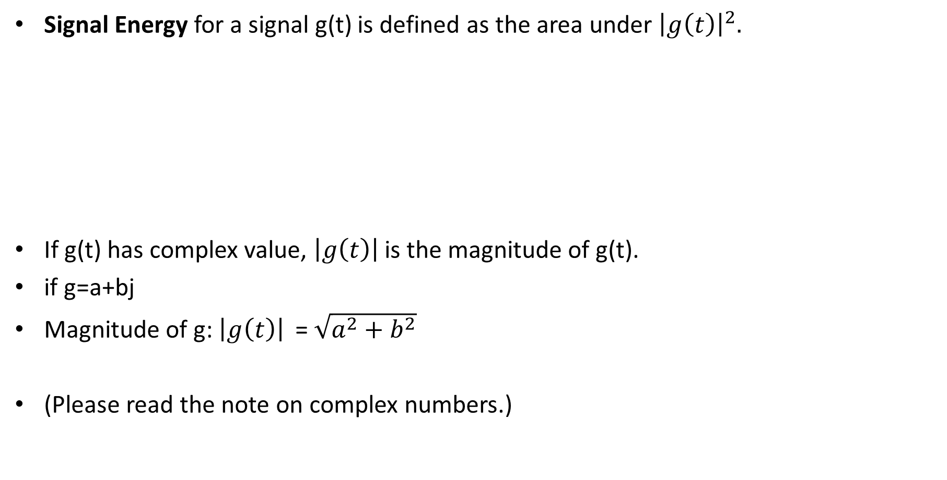
Signal Energy
Signal Energy for a signal g(t) is defined as the area under ${\left|g\left(t\right)\right|}^{2}.$
If g(t) has complex value, ${\left|g\left(t\right)\right|}^{ }$is the magnitude of g(t).
if g=a+bj
Magnitude of g: ${\left|g\left(t\right)\right|}^{ }$= $\sqrt{a^{2}+b^{2}}$
(Please read the note on complex numbers.)
Notes:
One thing that we need to measure about a signal is its energy

Slide 5
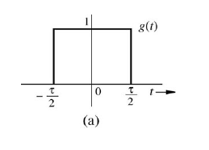
Example
Calculate the energy of the following signal
$$\int_{−∞}^{∞}{{|g\left(t\right)|}^{2}dt}$$

Slide 6
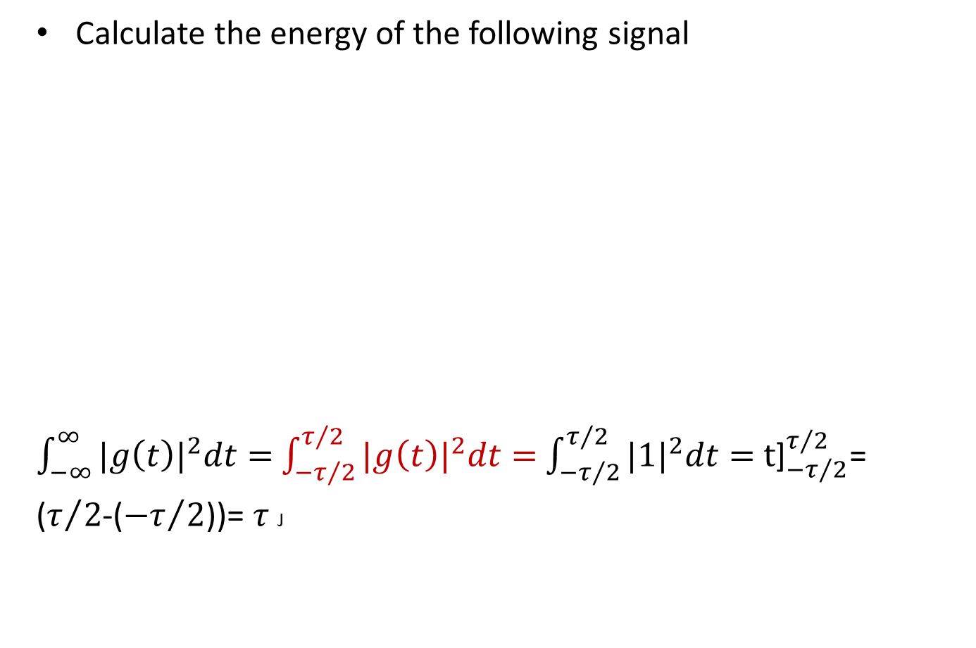
Example
Calculate the energy of the following signal
$\int_{−∞}^{∞}{{|g\left(t\right)|}^{2}dt=}$ $\int_{{−τ}/2}^{τ/2}{{|g\left(t\right)|}^{2}dt=}$ $\int_{{−τ}/2}^{τ/2}{{|1|}^{2}dt=}$ ${\text{t}\text{]}}_{{−τ}/2}^{τ/2}$=
($τ/2$-(${−τ}/2$))= $τ$ J
$\int_{−∞}^{∞}{{|g\left(t\right)|}^{2}dt=}\int_{−∞}^{{−τ}/2}{{|g\left(t\right)|}^{2}dt+\int_{{−τ}/2}^{τ/2}{{|g\left(t\right)|}^{2}dt+}}$ $\int_{τ/2}^{∞}{{|g\left(t\right)|}^{2}dt}$

Slide 7
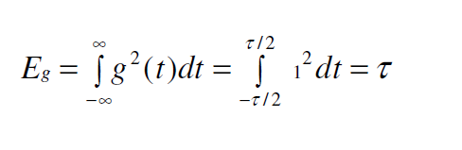
Example
Calculate the energy of the following signal
Answer

Slide 8
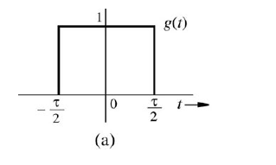
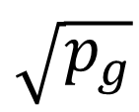


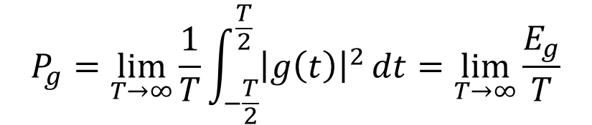
Signal Power
Signal power
Simply we can say power is the average of energy
Signal power is the time average (mean) of the signal amplitude squared → called the mean squared of g(t)
Root mean square (rms)
For previous example:
$$P_{g}=\lim_{T→∞}{\frac{1}{T}\int_{−\frac{T}{2}}^{\frac{T}{2}}{{\left|g\left(t\right)\right|}^{2}}dt=\lim_{T→∞}{\frac{E_{g}}{T}}}$$
$$\sqrt{p_{g}}$$

Slide 9
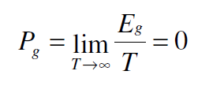
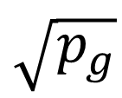
Signal Power
Signal power
Simply we can say power is the average of energy
Signal power is the time average (mean) of the signal amplitude squared → called the mean squared of g(t)
Root mean square (rms)
For previous example:
$$P_{g}=\lim_{T→∞}{\frac{1}{T}\int_{−\frac{T}{2}}^{\frac{T}{2}}{{\left|g\left(t\right)\right|}^{2}}dt=\lim_{T→∞}{\frac{E_{g}}{T}}}$$
$$\sqrt{p_{g}}$$
Power of a time limited (non-periodic) signal is zero, if we look at it over a long time

Slide 10
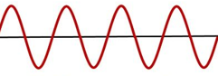
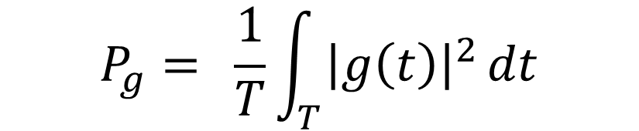
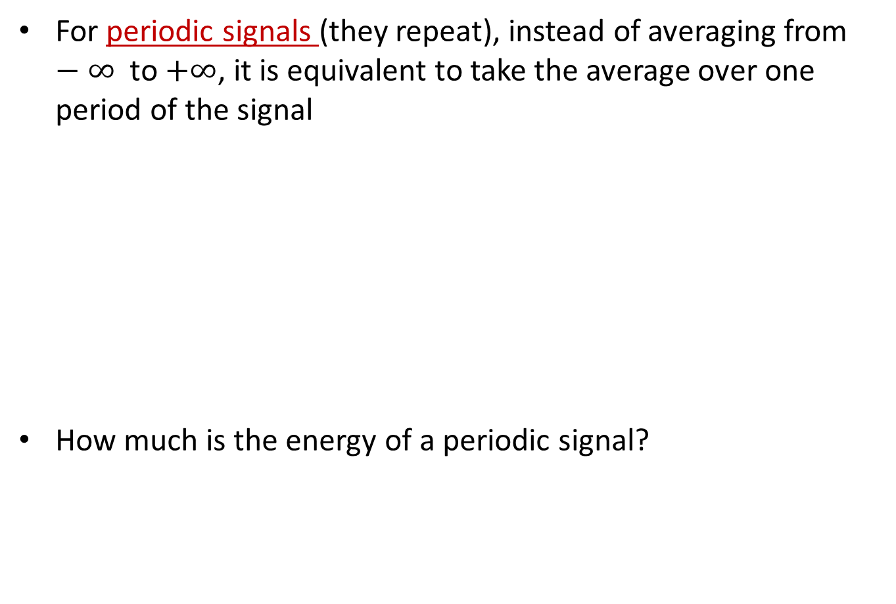
Power of periodic signals
For periodic signals (they repeat), instead of averaging from $−∞$ to $+∞$, it is equivalent to take the average over one period of the signal
How much is the energy of a periodic signal?
. . .
T
. . .
$$P_{g}=\underset{ }{}{\frac{1}{T}\int_{T}^{ }{{\left|g\left(t\right)\right|}^{2}}dt}$$

Slide 11
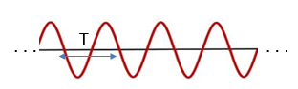

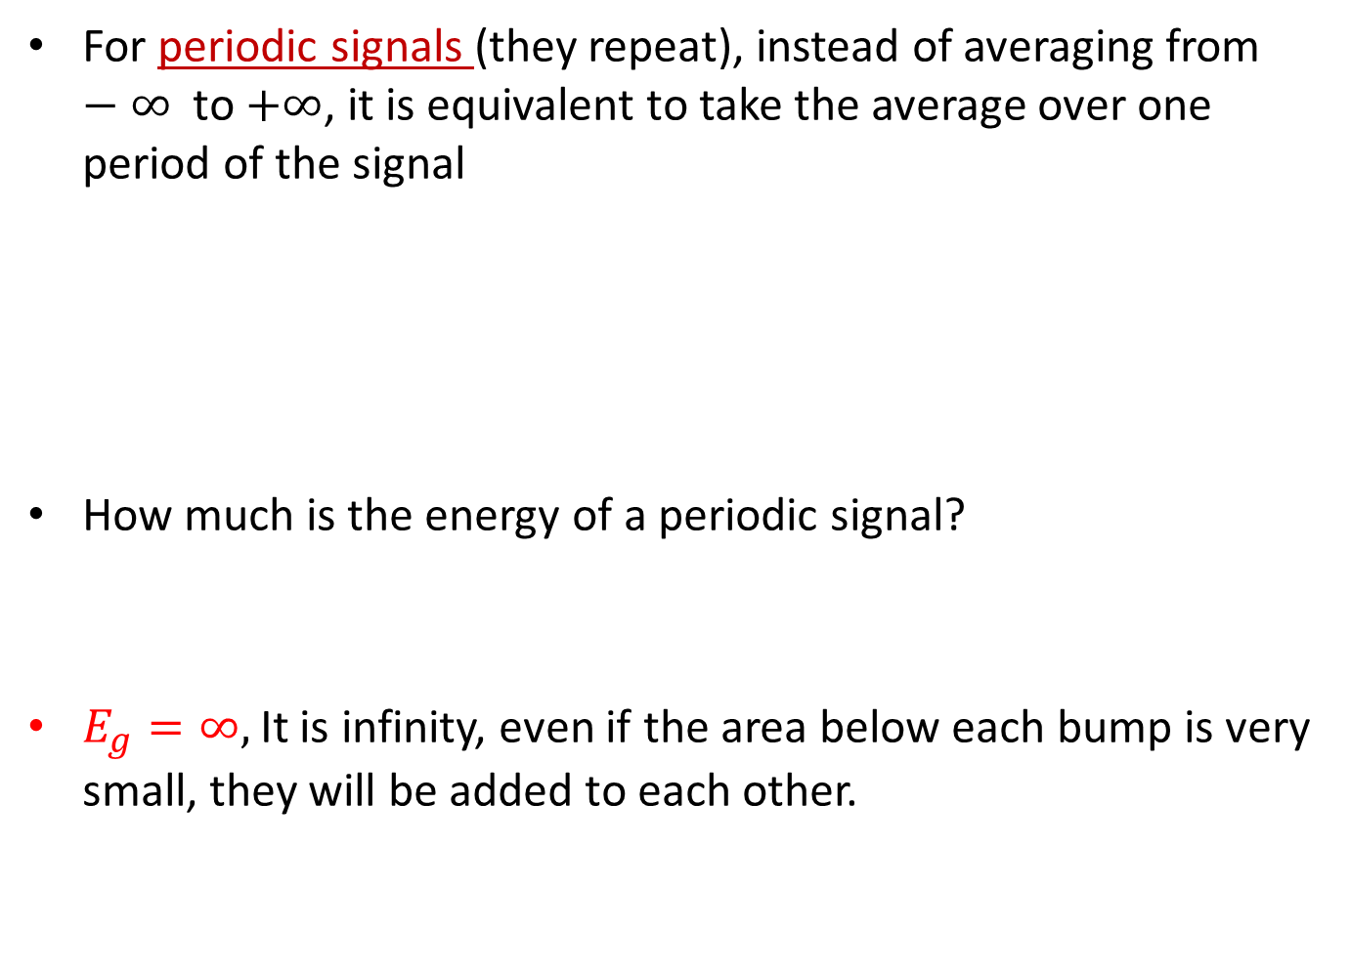
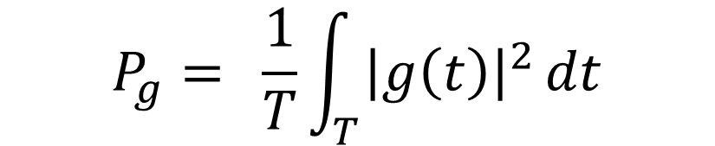
Power of periodic signals
For periodic signals (they repeat), instead of averaging from $−∞$ to $+∞$, it is equivalent to take the average over one period of the signal
How much is the energy of a periodic signal?
$E_{g}=∞,$It is infinity, even if the area below each bump is very small, they will be added to each other.
$$P_{g}=\underset{ }{}{\frac{1}{T}\int_{T}^{ }{{\left|g\left(t\right)\right|}^{2}}dt}$$

Slide 12
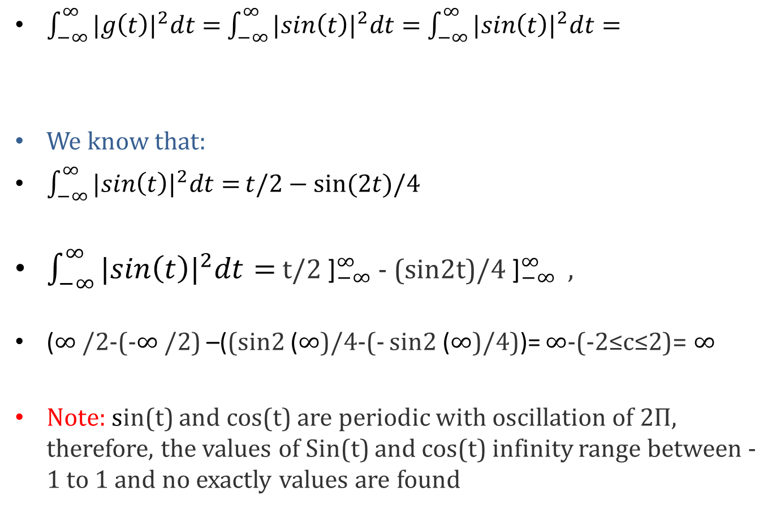
Energy of a periodic signal
$\int_{−∞}^{∞}{{|g\left(t\right)|}^{2}dt=}$ $\int_{−∞}^{∞}{{|sin\left(t\right)|}^{2}dt=}$ $\int_{−∞}^{∞}{{|sin\left(t\right)|}^{2}dt=}$
We know that:
$\int_{−∞}^{∞}{{|sin\left(t\right)|}^{2}dt=}t/2−sin⁡(2t)/4$
$\int_{−∞}^{∞}{{|sin\left(t\right)|}^{2}dt=}$ t/2 ${\text{]}}_{−∞}^{∞}$ - (sin2t)/4 ${\text{]}}_{−∞}^{∞}$ ,
($∞$/2-(-$∞$/2) –((sin2 ($∞$)/4-(- sin2 ($∞$)/4))= $∞$-(-2≤c≤2)= $∞$
Note: sin(t) and cos(t) are periodic with oscillation of 2Π, therefore, the values of Sin(t) and cos(t) infinity range between -1 to 1 and no exactly values are found

Slide 13
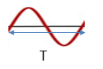
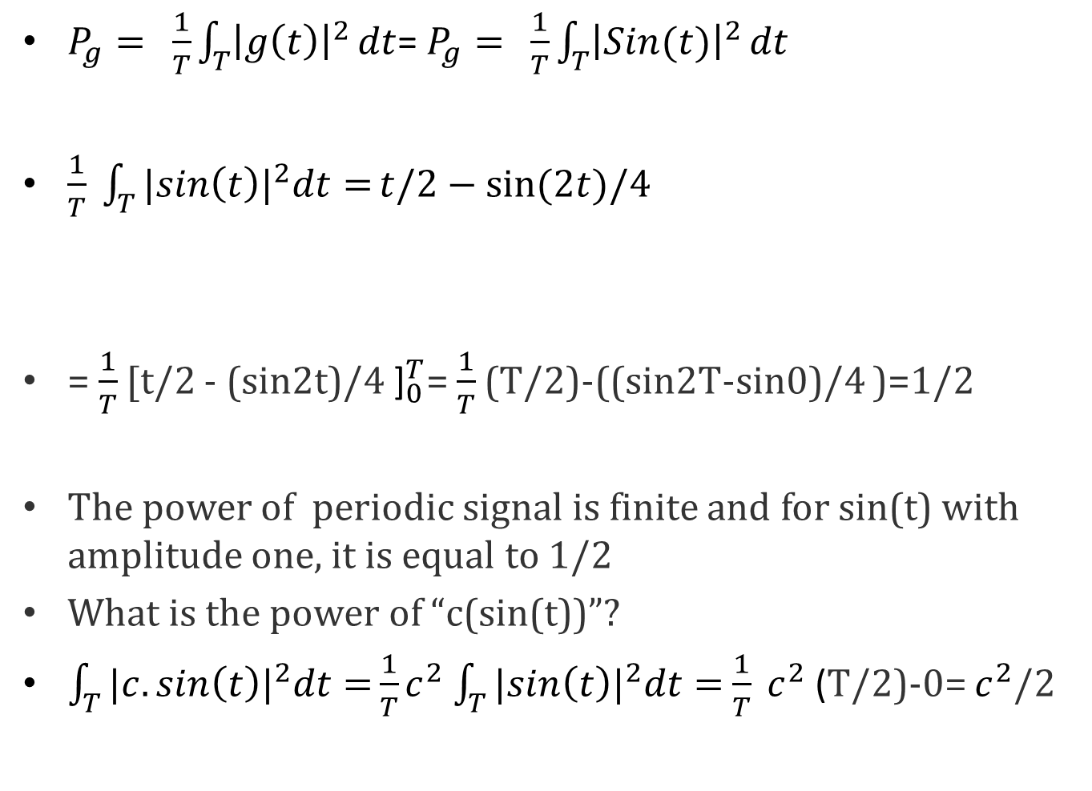
Power of a periodic signal
$P_{g}=\underset{ }{}{\frac{1}{T}\int_{T}^{ }{{\left|g\left(t\right)\right|}^{2}}dt}$= $P_{g}=\underset{ }{}{\frac{1}{T}\int_{T}^{ }{{\left|Sin(t)\right|}^{2}}dt}$
$\frac{1}{T} \int_{T}{{|sin\left(t\right)|}^{2}dt=}t/2−sin⁡(2t)/4$
= $\frac{1}{T}$[t/2 - (sin2t)/4 ${\text{]}}_{0}^{T}$= $\frac{1}{T}$(T/2)-((sin2T-sin0)/4 )=1/2
The power of periodic signal is finite and for sin(t) with amplitude one, it is equal to 1/2
What is the power of “c(sin(t))”?
$\int_{T}{{|c.sin\left(t\right)|}^{2}dt=}{\frac{1}{T}c}^{2}$ $\int_{T}{{|sin\left(t\right)|}^{2}dt=}$ $\frac{1}{T} c^{2}$ (T/2)-0= $c^{2}$/2
0

Slide 14
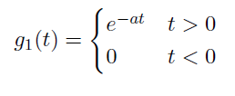



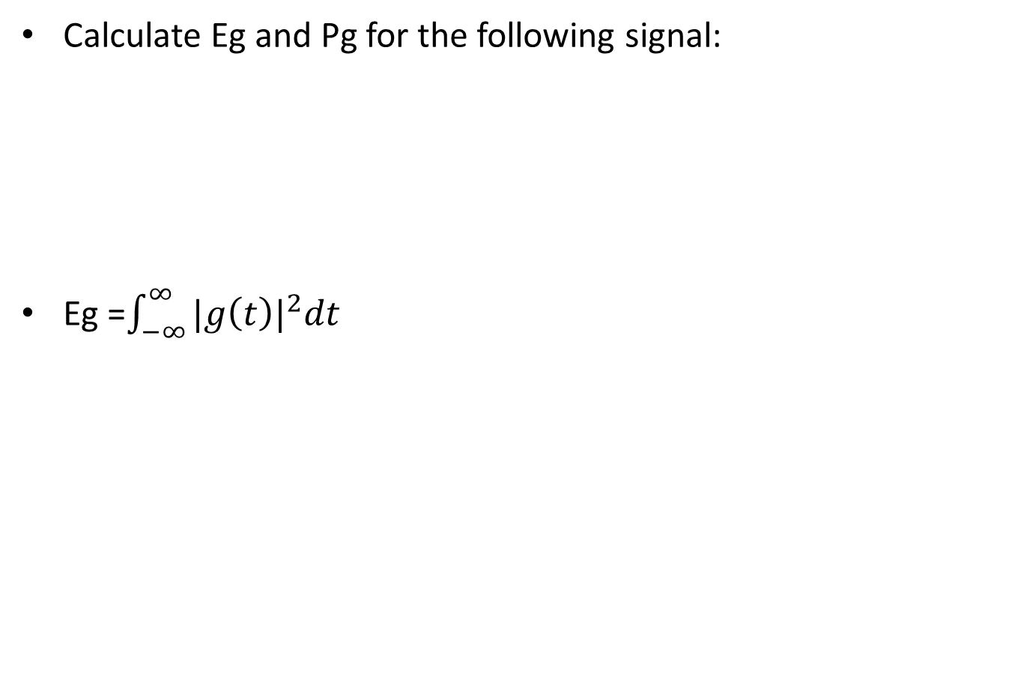


Examples
Calculate Eg and Pg for the following signal:
Eg =$\int_{−∞}^{∞}{{|g\left(t\right)|}^{2}dt}$

Slide 15
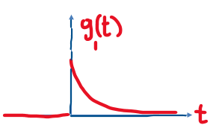
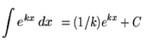
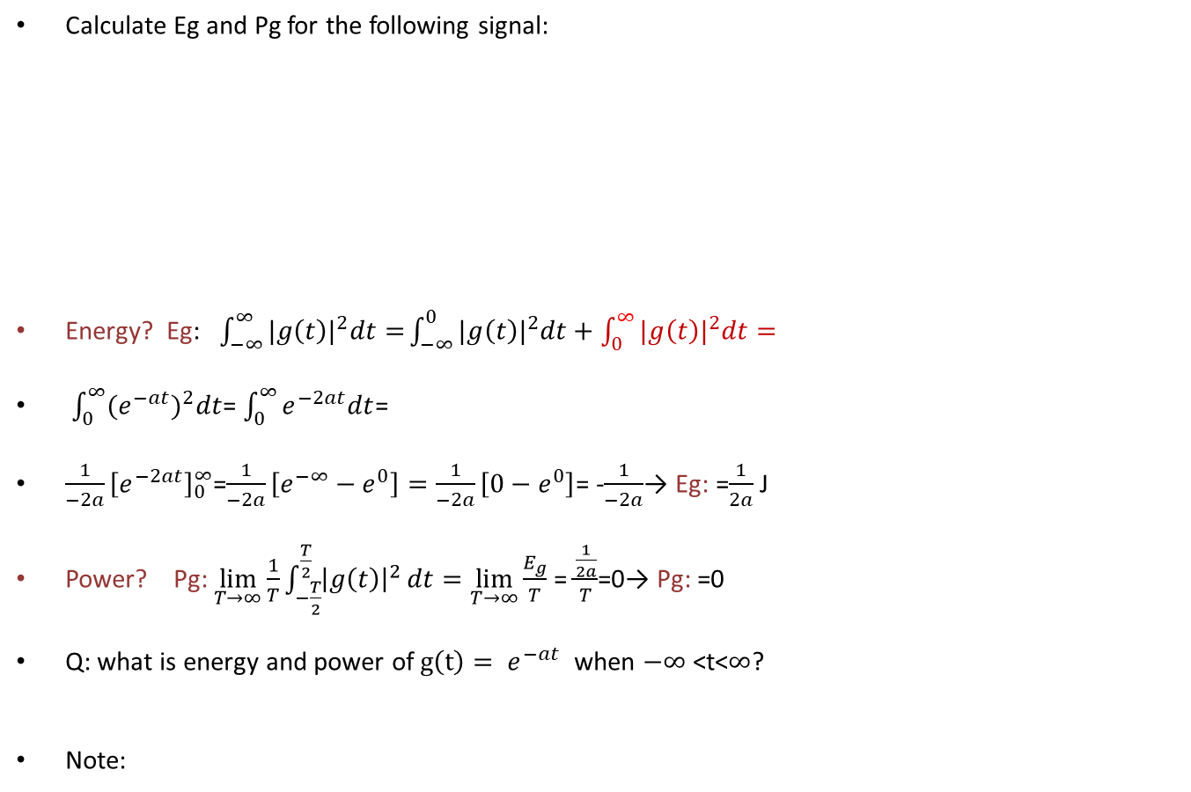
Examples
Calculate Eg and Pg for the following signal:
Energy? Eg: $\int_{−∞}^{∞}{{|g\left(t\right)|}^{2}dt=}\int_{−∞}^{0}{{|g\left(t\right)|}^{2}dt+\int_{0}^{∞}{{|g\left(t\right)|}^{2}dt=}}$
$\int_{0}^{∞}{{(e}^{−at})^{2}dt}$= $\int_{0}^{∞}{e^{−2at}dt}$=
$\frac{1}{−2a}{\left[e^{−2at}\right]}_{0}^{∞}$=$\frac{1}{−2a}\left[{e^{−∞}−e}^{0}\right]=\frac{1}{−2a}\left[{0−e}^{0}\right]$= -$\frac{1}{−2a}$→ Eg: =$\frac{1}{2a}$ J
Power? Pg: $\lim_{T→∞}{\frac{1}{T}\int_{−\frac{T}{2}}^{\frac{T}{2}}{{\left|g\left(t\right)\right|}^{2}}dt=\lim_{T→∞}{\frac{E_{g}}{T}}}$ = $\frac{\frac{1}{2a}}{T}$=0→ Pg: =0
Q: what is energy and power of$g\left(t\right)= e^{−at}$ when $−∞$ <t<$∞$?
Note:

Slide 16
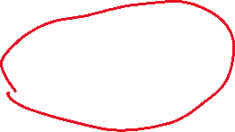


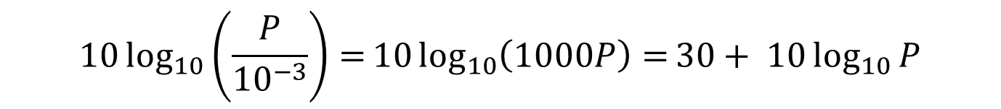
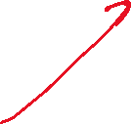
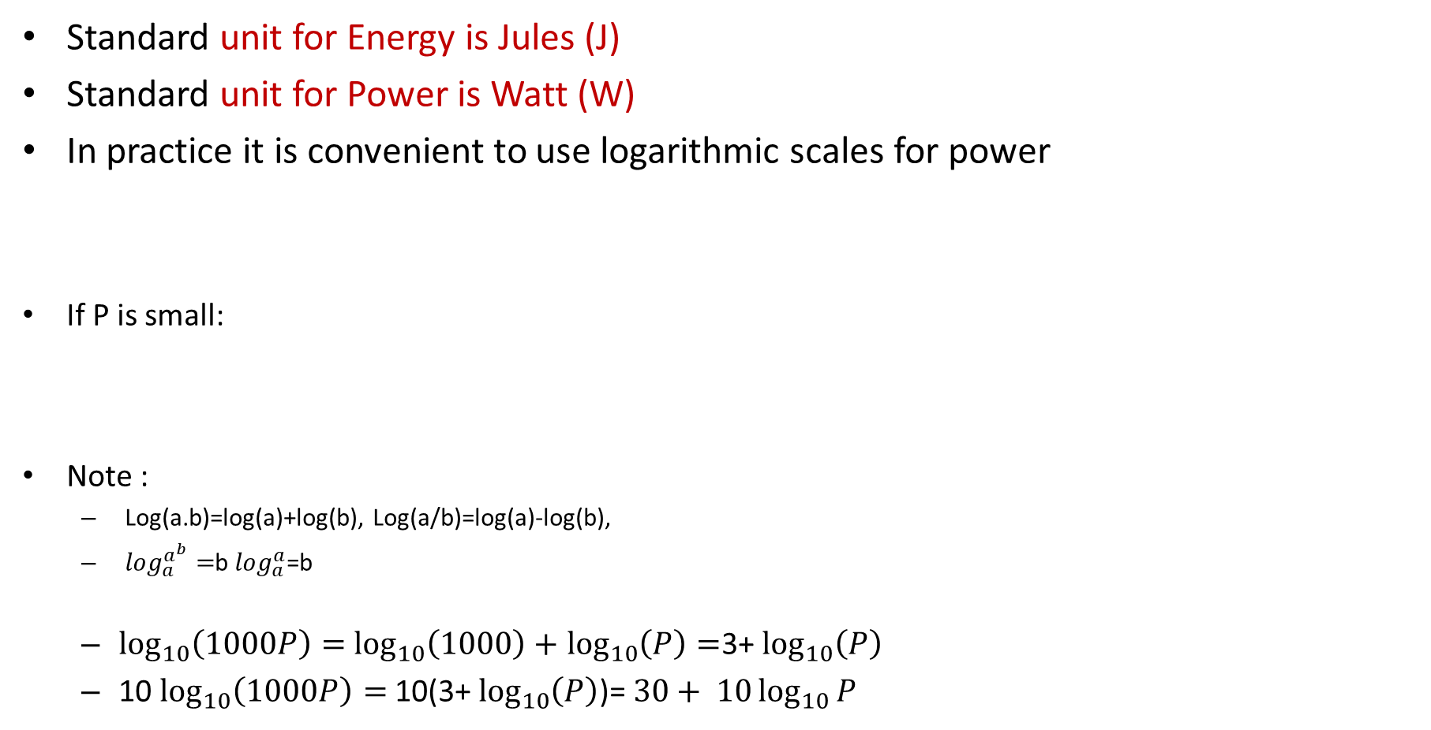



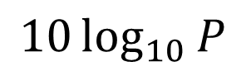


Units of Signal Energy and Power
Standard unit for Energy is Jules (J)
Standard unit for Power is Watt (W)
In practice it is convenient to use logarithmic scales for power
If P is small:
Note :
Log(a.b)=log(a)+log(b), Log(a/b)=log(a)-log(b),
$\log_{a}^{a^{b}}=$b $\log_{a}^{a}$=b
$\log_{10}\left(1000P\right)=$ $\log_{10}\left(1000\right)+$ $\log_{10}\left(P\right)=$3+ $\log_{10}\left(P\right)$
10 $\log_{10}\left(1000P\right)=$ 10(3+ $\log_{10}\left(P\right)$)= $30+ 10\log_{10}{P}$
$$10\log_{10}{P}$$
dBw
$$10\log_{10}\left(\frac{P}{{10}^{−3}}\right)=10\log_{10}\left(1000P\right)=30+ 10\log_{10}{P}$$
dBm

Slide 17
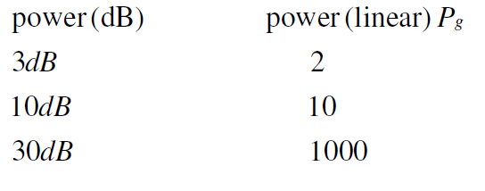
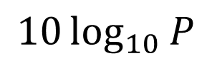

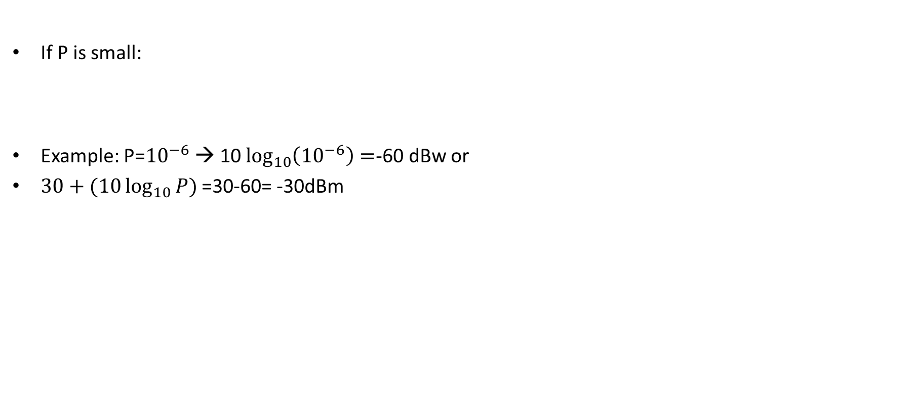



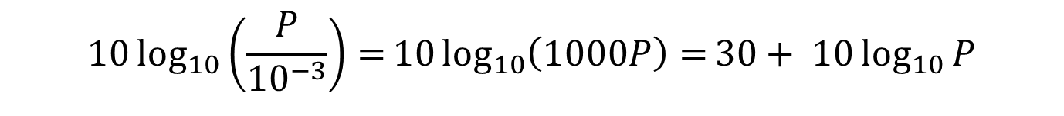
Units of Signal Energy and Power
$$10\log_{10}{P}$$
dBw
If P is small:
Example: P=${10}^{−6}$ → 10 $\log_{10}\left({10}^{−6}\right)=$-60 dBw or
$30+(10\log_{10}{P})$=30-60= -30dBm
$$10\log_{10}\left(\frac{P}{{10}^{−3}}\right)=10\log_{10}\left(1000P\right)=30+ 10\log_{10}{P}$$
dBm

Slide 18
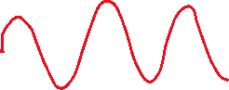
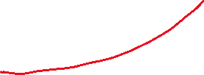
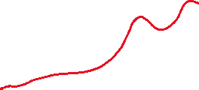
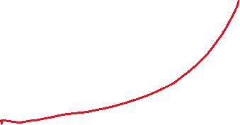
2.2 Classification of Signals
Continuous-time and discrete-time signals
Analog and digital signals
Periodic and aperiodic signal
Energy and power signals
Deterministic and probabilistic signals

Slide 19
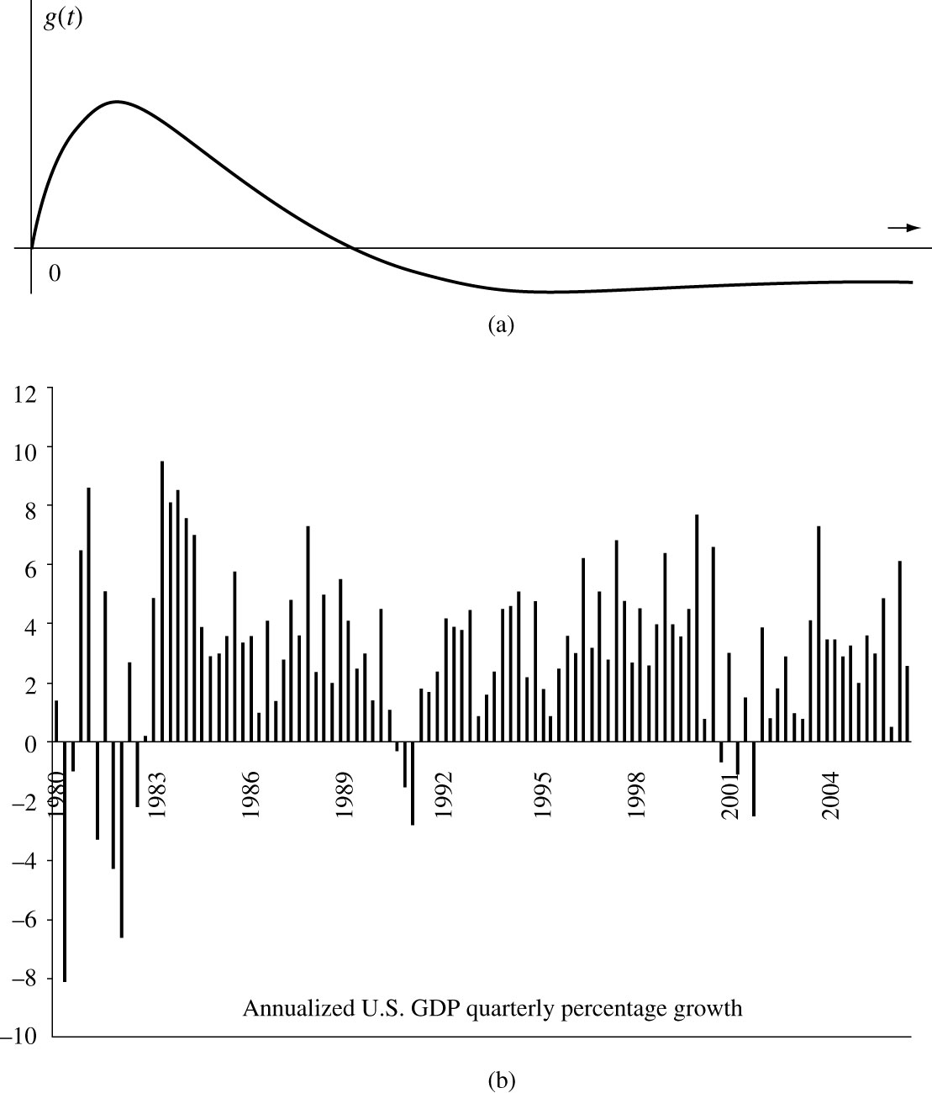
CT vs. DT
Continues time (CT) signal is defined for a continuous range of time
Discrete-time (DT)signal is defined only for discrete times
Figure 2.3 (a) Continuous time and (b) discrete time signals.

Slide 20
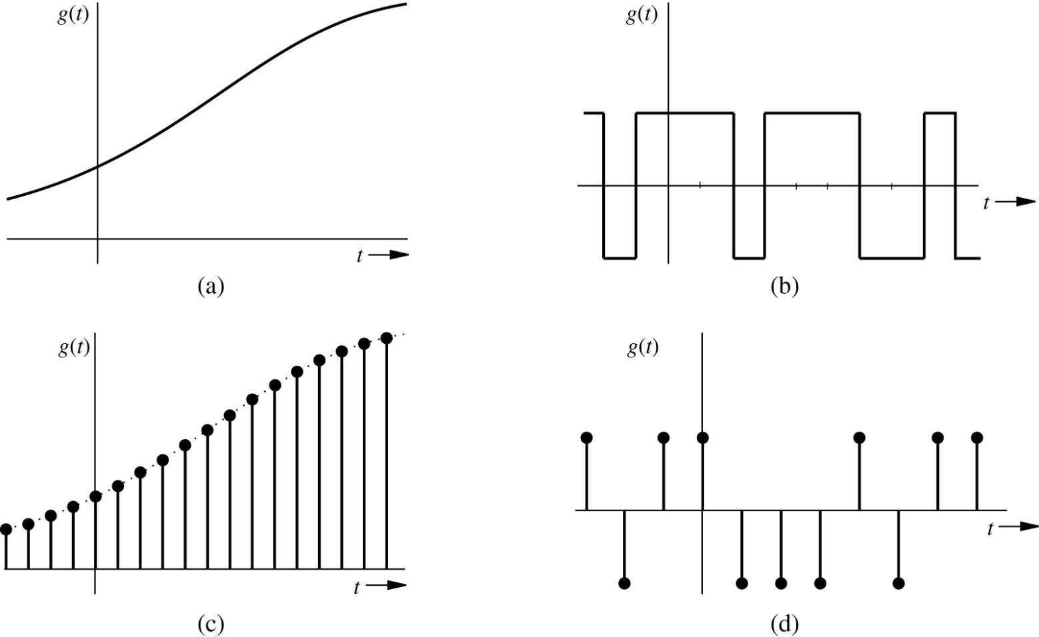

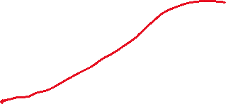

Analog vs Digital
Analog signal: its amplitude can take on an infinite number of values
Digital signal: its amplitude can only take finite number of values
CT and DT describe the nature of the signal along the time (horizontal axis) while Analog and Digital describes the nature of the amplitude of the signal (Vertical axis)

Slide 21
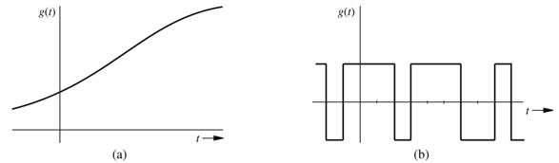
Analog vs Digital
Analog signal: its amplitude can take on an infinite number of values
Digital signal: its amplitude can only take finite number of values
CT and DT describe the nature of the signal along the time (horizontal axis) while Analog and Digital describes the nature of the amplitude of the signal (Vertical axis)
CT & Analog
CT & Digital

Slide 22
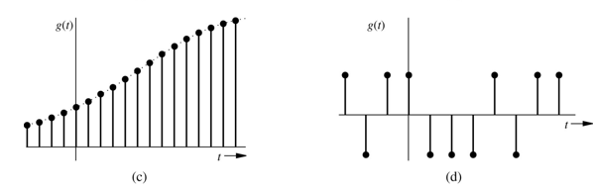

Analog vs. Digital
Analog signal: its amplitude can take on an infinite number of values
Digital signal: its amplitude can only take finite number of values
CT and DT describe the nature of the signal along the time (horizontal axis) while Analog and Digital describes the nature of the amplitude of the signal (Vertical axis)
DT & Analog
DT & Digital

Slide 23
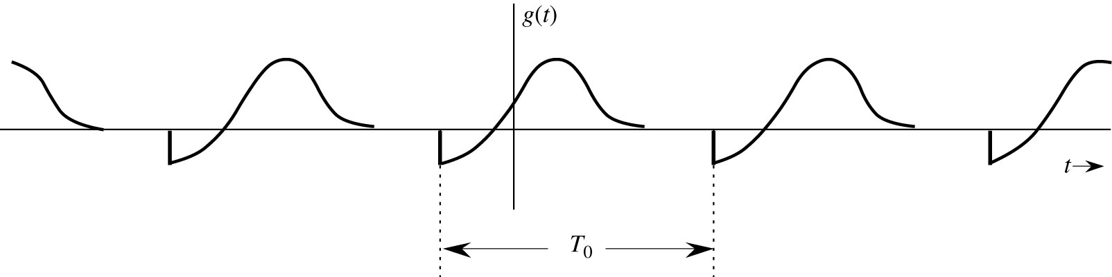



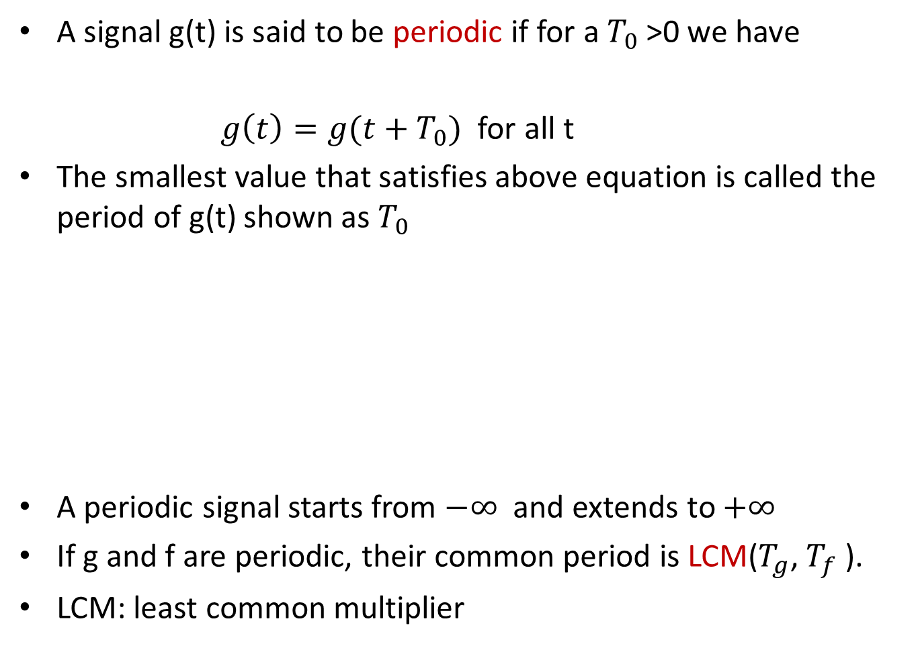
Periodic vs Aperiodic signal
A signal g(t) is said to be periodic if for a $T_{0}$>0 we have
$g\left(t\right)=g(t+T_{0})$ for all t
The smallest value that satisfies above equation is called the period of g(t) shown as $T_{0}$
A periodic signal starts from $−∞$ and extends to $+∞$
If g and f are periodic, their common period is LCM($T_{g}$, $T_{f}$ ).
LCM: least common multiplier
Periodic signal of period T₀.

Slide 24
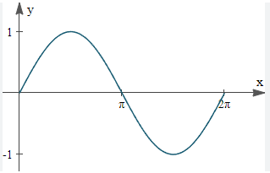
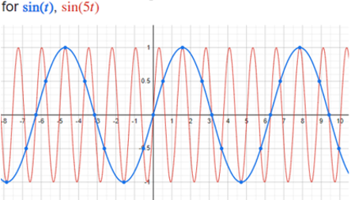


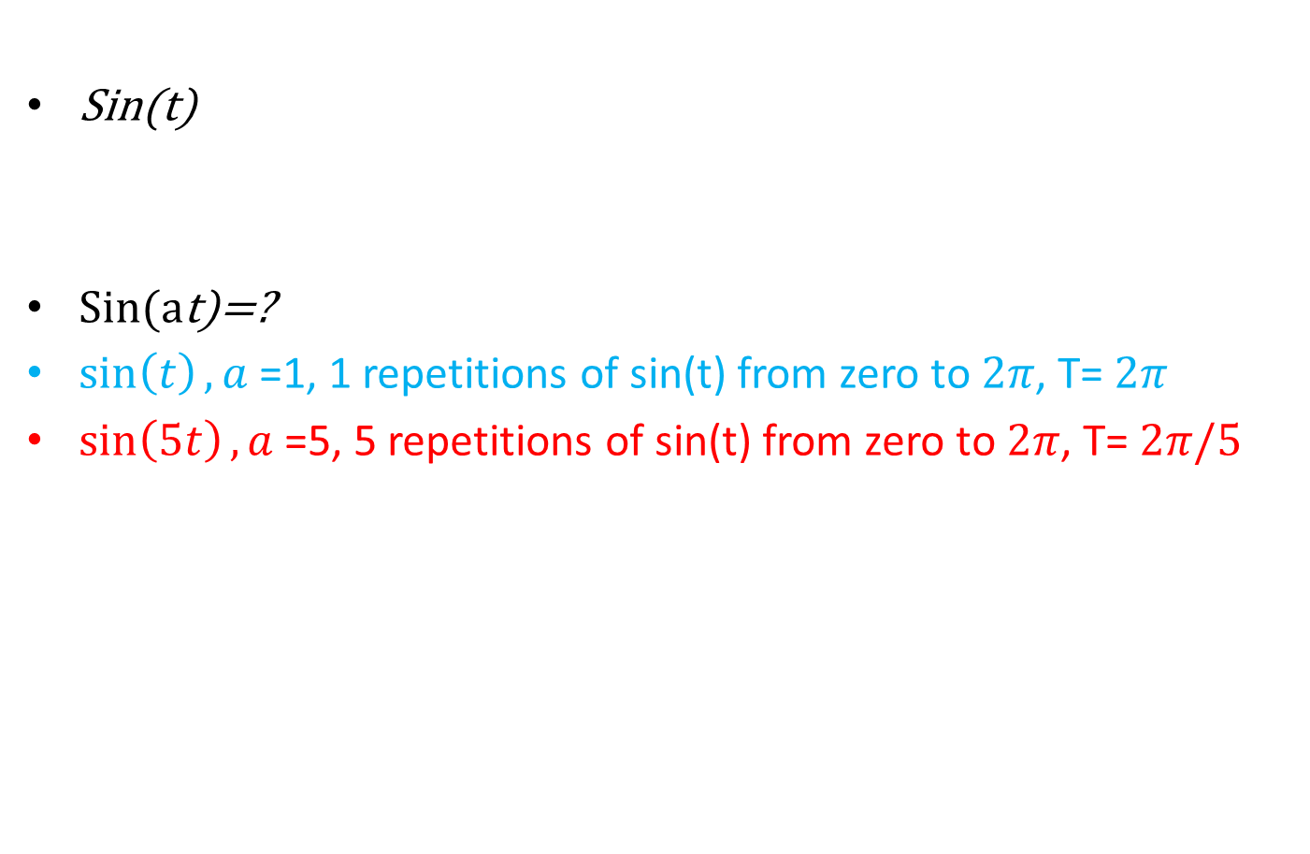






Example of a Periodic Signal
Sin(t)
Sin(at)=?
$\sin\left(t\right),a$=1, 1 repetitions of sin(t) from zero to $2π$, T= $2π$
$\sin\left(5t\right),a$=5, 5 repetitions of sin(t) from zero to $2π$, T= $2π/5$

Slide 25






























Review
g(t)
g(t), period =$T_{1}$
g(2t), shape and period $T_{2}$?
For shape, we can look at places that g(t) becomes zero on time (t). It is at zero, $T_{1}$/2, and $T_{1}$.
Check these places for g(2t),
When 2t=0→t=0
When 2t= $T_{1}$/2→t= $T_{1}$/4
When 2t= $T_{1}$ (g(t) period →t= $T_{1}$/2
Thus, the period for g(2t): $T_{2}=T_{1}$/2
g($ω_{0}$t), $ω_{0}$≥3, shape and period $T_{3}$?
when $ω_{0}$t=0→t=0
When $ω_{0}$t= $T_{1}$/2→t= $T_{1}$/2$ω_{0}$
When $ω_{0}$t= $T_{1}$→t= $T_{1}$/$ω_{0}$
Thus, the period for g(ꙍt): $T_{3}=T_{1}$/ $ω_{0}$
The same thing happens for the period of sin($ω_{0}$t),
The period for sin(t) is $T_{0}$= $2π$
$\text{Thus}\text{, }\text{the} \text{period} \text{for} \text{sin}\text{(}ω_{0}\text{t}\text{):}T=T_{0}$/ $ω_{0}$= $2π$/ $ω_{0}$
T is a constant value, t is a time variable, and g(t) is periodic with period T or mT (multiples of T),
$T_{1}$/2
…
…
t
$T_{1}$ :(g(t) period)
$T_{1}$/4
g(2t)
…
…
t
$T_{1}$/2
$T_{1}$/2 $ω_{0}$
g($ω_{0}$t)
…
…
t
$T_{1}$/ $ω_{0}$

Slide 26
















































Examples
Determine if the following signals are periodic or not? If periodic, what is T?
Ex1: $g\left(t\right)=cos⁡(ω_{0}t)$
Ex2:
What is period of $\cos\left(πt\right)$?
What is period of $\cos\left(2πt/5\right)$?
What is period of $\cos\left(πt\right)+cos⁡(2πt/5)$ ?
$\cos\left(t\right),ω_{0}$=1, T= $2π$

Slide 27








Examples cont.
Determine if the following signal is periodic or not? If periodic, what is T?
Ex1: $g\left(t\right)=cos⁡(ω_{0}t)$
We also know that for all a: cos(a)=cos(a+ $2π$)
Assume a= $ω_{0}t$
If periodic we should have: $g\left(t\right)=g\left(t+T\right)$
$\cos\left(ω_{0}t\right)=$ $\cos\left(ω_{0}(t+T\right))$
$\cos\left(ω_{0}t\right)$= $\cos\left(ω_{0}t+ω_{0}T\right)$
$$ω_{0}T=2π$$
$$T=2π/ ω_{0}$$
→ $\cos\left(ω_{0}t\right)=\cos\left(ω_{0}t+2π\right)$

Slide 28









Examples cont.
Ex2:
What is period of $\cos\left(πt\right)$?
What is period of $\cos\left(2πt/5\right)$?
What is period of $\cos\left(πt\right)+cos⁡(2πt/5)$ ?
$\cos\left(πt\right),$ $T=2π/ ω_{0}=2π/π$=2 sec,
every 2 seconds it repeats itself
$cos⁡(2πt/5),$ $T=2π/(\frac{2π}{5})=5$ sec
T=LCM(2, 5) = 10.

Slide 29






Energy and Power Signals
A signal with finite energy is called an energy signal
A signal with a finite and non-zero power is called a power signal
$$<∞$$
$$0<\lim_{T→∞}{\frac{1}{T}\int_{−\frac{T}{2}}^{\frac{T}{2}}{{\left|g\left(t\right)\right|}^{2}}dt<∞}$$
Energy signal
Power signal
Notes:
energy signal has a finite value for energy and zero for power since for energy t goes to infinity thus any number divided by infinity goes to zero.

Slide 30











Three Classes of Signals (2)
A finite signal of finite length
Case I
energy signal
A periodic & finite signal
Case II
power signal
$$0<P_{∞}<∞$$
A constant signal
Case III
otherwise
A signal of infinite length that goes to infinity

Slide 31





Energy and Power of Constant Signal
$E_{g}$=? , $P_{g}$=?,
$E_{g}$= $\int_{−∞}^{∞}{{|g\left(t\right)|}^{2}dt=}$ $\int_{−∞}^{∞}{c^{2}dt=}$ $c^{2}t$= $∞$
Power?
$P_{g}=\lim_{T→∞}\frac{1}{T}\int_{−\frac{T}{2}}^{\frac{T}{2}}{{\left|g\left(t\right)\right|}^{2}}dt{=}$ $\frac{1}{T}\int_{−\frac{T}{2}}^{\frac{T}{2}}{c^{2}}dt{=}$ $\frac{1}{T} [c^{2}t{\text{]}}_{−\frac{T}{2}}^{\frac{T}{2}}$
= $\frac{1}{T}[c^{2}$($\frac{T}{2}$-(- $\frac{T}{2}$)]=$\frac{1}{T}[c^{2}T$]= $c^{2}$
Note that we may compute the power by averaging its energy over one period for the periodic case. However, we the sake of generality we can solve this problem by averaging over infinity large time intervals.
c

Slide 32









Deterministic and Probabilistic signals
Deterministic signals
A signal whose description is known completely, in mathematical or graphical way, is a deterministic signal
Deterministic signals: no matter how many times repeated, they stay the same.
Probabilistic signals
If a signal is only known in terms of probabilistic description such as mean value, mean squared value,…is a random signal. Most of the noise signals are random
It is like flipping a coin several times e.g.: 5 times, each time we repeat the experiment, we may get different set of outcomes (head or tail).

Slide 33
Some Useful Signal Operations

Slide 34







Time Shifting
g(t)
T>0
g(t-T) means g(t) is delayed by T sec
T<0
g(t+T) means g(t) is advanced by T sec
Figure 2.6 Time shifting a signal.

Slide 35





Time Scaling
Time scaling g(at)
t
C
D
t
Scaling factor a>1, signal is compressed.
Scaling factor a<1, signal is stretched.

Slide 36








Time Scaling
Example:
Compressed by a factor 2
Expanded by a factor 2

Slide 37












Examples

Slide 38




Time Inversion g(-t)
g(-t): rotate the signal about the vertical axis (mirror image of the signal about the vertical axis)
Figure 2.9 Time inversion (reflection) of a signal.

Slide 39







Time Inversion g(-t)

Slide 40

-g(t)
Recall: -g(t) is the mirror image of the signal about the horizontal axis
g(t)
g(-t)
t
t
-g(t)
t

Slide 41



Shift and scale
A general transformation of x(t) is defined as
The systematic approach to obtain the transformed signal is
First, shift (delay or advance) the signal in accordance to
Then, perform time scaling or reversal of on the delayed or advanced signal.

Slide 42





Example 1
Find
Step 1: shift
Step 2: time reverse

Slide 43












Example 2

Slide 44


2.4 Unit Impulse Function
$δ\left(t\right)$: unit impulse function, also known as “Dirac Delta”
We can think of unit impulse as the limit of
(defined below) when
Unit area
By decreasing , the width of the rectangle decreases and height of it increases.
However, the area of the rectangle is always 1.

Slide 45








Unit Impulse Function (2)
The unit impulse function is defined as
$2δ\left(t\right)$?
Shows the area

Slide 46















Multiplication by an Impulse
Similarly:
First set to zero inside of $δ$: t-T=0 →t=T, the only non-zero term for $Φ\left(t\right) multiplied by δ\left(t−T\right)$ is when t=T in $Φ\left(t\right)$, which is $Φ\left(T\right)$
Thus: $Φ\left(t\right)δ\left(t−T\right)=Φ\left(T\right)δ\left(t−T\right)$
$$Φ\left(t\right)δ\left(t\right)=Φ\left(0\right)δ\left(t\right)$$
$$Φ\left(t\right)δ\left(t−T\right)=$$
$$Φ\left(T\right)δ\left(t−T\right)$$

Slide 47









Example:Multiplication by an Impulse
$$Φ\left(t\right)$$
$$Φ\left(t\right)$$
a
--------------
t
t
$$δ\left(t\right)$$
$$δ\left(t\right)$$
t
t
$$δ\left(t−T\right)$$
t
t
$$Φ\left(t\right)δ\left(t\right)=Φ\left(0\right)δ\left(t\right)$$
$Φ\left(t\right)δ\left(t−T\right)=Φ\left(T\right)δ\left(t−T\right)$=a $δ\left(t−T\right)$

Slide 48










Example: Multiplication by an Impulse 2
$$Φ\left(t\right)$$
$$Φ\left(t\right)$$
3
4
--------------
t
t
$$δ\left(t\right)$$
$$δ\left(t\right)$$
t
t
$$δ\left(t−2\right)$$
t
t
$Φ\left(t\right)δ\left(t\right)=Φ\left(0\right)δ\left(t\right)$= 3$δ\left(t\right)$
$Φ\left(t\right)δ\left(t−T\right)=Φ\left(2\right)δ\left(t−2\right)$= 4$δ\left(t−2\right)$
$Φ\left(t\right)δ\left(t+T\right)=?$

Slide 49







Sampling property of unit impulse
Sampling or sifting property of unit impulse:
The area under the product of a function with an impulse is equal to the value of the function at the instant where the unit impulse is located
This is called the "sifting" property because the impulse function $δ\left(t−T\right)$sifts through the function $Φ\left(t\right)$and pulls out the value $Φ\left(T\right)$
$remember the example: Φ\left(2\right)δ\left(t−2\right)$= 4$δ\left(t−2\right)$
$\int_{−∞}^{+∞ }{Φ\left(t\right)δ\left(t−T\right)dt=}$ $\int_{−∞}^{+∞ }{Φ\left(2\right)δ\left(t−2\right)\text{=}Φ\left(2\right)\int_{−∞}^{+∞ }{δ\left(t−2\right)\text{= }}4}$
$$\int_{−∞}^{+∞ }{Φ\left(t\right)δ\left(t−T\right)dt=}Φ\left(T\right)\int_{−∞}^{+∞ }{δ\left(t−T\right)dt=}Φ\left(T\right)$$

Slide 50













Unit Impulse examples
($e^{−2t}$+10) ${\text{(}\text{t}\text{−5+1)}}^{1000}$ $δ\left(t−5\right)$=?
($e^{−t}$) ${\text{(}\text{t}\text{+11}\text{)}}^{100}$ $δ\left(t+10\right)\text{= }$?
($e^{−t}$) $(t+15)$ $δ\left(t\right)\text{= }$?

Slide 51














Unit Step Function u(t)
We know that$\int_{−∞}^{∞}{δ\text{(}τ )}$d$τ=1$
How about
$\int_{−∞}^{t }{δ\text{(}τ )}$d$τ$
$$τ$$
$$\int_{−∞}^{t }{δ\text{(}τ )}\text{d}τ=\left\{\begin{matrix}1, & t≥0 \\ 0, & t<0\end{matrix}\right.$$
$$τ$$

Slide 52




Unit Step Function u(t) cont.
Another important signal: unit step function
If we want a signal to start at t=0 (causal signal), we need only to multiply it by u(t)

Slide 53







The Relationship between Unit Impulse and Unit Step Functions
Unit step is the integral of unit impulse
Unit Impulse is the derivate of unit step

Slide 54







2.5 Signals vs. Vectors
There is a strong connection between signals and vectors
Consider signal g(t) defined in the interval [a,b]
As , the number of samples N → infinity, and vector g transforms to the continuous-time signal g(t)
Indeed, CT signals are a generalization of finite dimension vectors
Operations in vector space can be applied for CT signals
g(t)
t₁=a
t₂=a+$ε$
t₃=a+2$ε$
t_{N}=b
g=[g(t₁) g(t₂) ….. g(t_{N})]
N-dimensional vector
$$ε→0$$

Slide 55











Inner Product and Norm of Vectors
Denote a vector with bold symbol
For a vector x, $magnitude or length: \left\|x\right\|$=$\sqrt{x_{1}^{2}+x_{2}^{2}+…+x_{N}^{2}}$
Inner product (or dot product)
$$<g,x> = \left\|g\right\|\left\|x\right\| cosθ$$
Where $θ is the angle between g and x$
${\left\|g\right\|}^{2}=<g,g>$ , we call $||g||$ as the length or norm of vector g.
g and x are orthogonal if their inner product is zero: $<g,x>$=0
What if not orthogonal?
Can one have some components along another one?
$$<g,x> =\sum_{i=1}^{N}{g_{i}x_{i}}$$

Slide 56



Component of a vector along another vector
Consider vectors g and x
What is the approximation of g in the direction of x?
If we want to approximate g with cx, then e=g-cx is the estimation error.
Which decomposition gives us the smallest error?
When e is perpendicular to x: this is called the projection of g along x.
$$g=cx+e=c_{1}x+e_{1}=c_{2}x+e_{2}$$

Slide 57









Component of a vector along another vector (2)
C=?
$$\left\|g\right\|cosθ$$
$$c\left\|x\right\|=\left\|g\right\|cosθ$$
Multiply both sides with ||x||
$$c{\left\|x\right\|}^{2}=\left\|x\right\|\left\|g\right\|cosθ=<g,x>$$
$c=\frac{<g,x>}{{\left\|x\right\|}^{2}}$ $=\frac{<g,x>}{<x,x>}$
a
(1)
c
b
b=acos(ϴ)
c=asin(Ɵ)

Slide 58










2.5.2 Decomposition of a Signal and Signal Components
The concepts of vector components and orthogonality can be extended to continuous time signals.
Suppose we want to approximate signal g(t) in terms of signal x(t) over interval [t1,t2]:
Error in approximation:
We need to minimize the error signal, that is, minimize its norm.
Minimum signal norm corresponds to minimum energy $E_{e}$ over the interval $[t_{1,}t_{2}]$
Best approximation: minimize the energy of e(t)
How to minimize $E_{e}$?
$$g\left(t\right)≅cx(t)$$
$$e\left(t\right)=g\left(t\right)−cx\left(t\right), t∈[t_{1,}t_{2}]$$

Slide 59







Decomposition of a Signal (2)
This is a function of c and is minimized by
$$\frac{dE_{e}}{dc}=0$$
0
$$\frac{d}{dc}\left[\int_{t_{1}}^{t_{2}}{g^{2}\left(t\right)dt}\right]−\frac{d}{dc}\left[2c\int_{t_{1}}^{t_{2}}{g\left(t\right)x\left(t\right)dt}\right]+\frac{d}{dc}\left[c^{2}\int_{t_{1}}^{t_{2}}{x^{2}\left(t\right)dt}\right]=0$$
$$−\left[2\int_{t_{1}}^{t_{2}}{g\left(t\right)x\left(t\right)dt}\right]+\left[2c\int_{t_{1}}^{t_{2}}{x^{2}\left(t\right)dt}\right]=0$$

Slide 60












Decomposition of a Signal (3)
To summarize, if a signal g(t) is approximated by another signal x(t) as
Then the optimum value of c that minimizes the energy of error signal is given by Equation (2) .
We say cx(t) is the projection of g(t) on x(t)
$$c=\frac{\int_{t_{1}}^{t_{2}}{g\left(t\right)x\left(t\right)dt}}{\int_{t_{1}}^{t_{2}}{x^{2}\left(t\right)dt}}$$
$$=\frac{1}{E_{x}}\int_{t_{1}}^{t_{2}}{g\left(t\right)x\left(t\right)dt}$$
(2)
$$g\left(t\right)≅cx(t)$$

Slide 61











Orthogonality of Signals and inner product
The concepts of vector components and orthogonality can be directly extended to continuous time signals.
If the component of g(t) does not have any x(t) (that is c=0), we say g(t) and x(t) are orthogonal in [t1,t2]
Two signals are orthogonal if and only if their inner product is zero.
$$\int_{t_{1}}^{t_{2}}{g\left(t\right)x\left(t\right)dt=0}$$
$$<g,x> =\sum_{i=1}^{N}{g_{i}x_{i}}$$
Similar to inner product of vectors
$$<g\left(t\right),x\left(t\right)> =\int_{t_{1}}^{t_{2}}{g\left(t\right)x\left(t\right)dt}$$
inner product of signals

Slide 62








Norm of a signal g(t)
from
We have
Or norm of g(t) is the square root of the signal energy in the given time interval
And
$$<g\left(t\right),x\left(t\right)> =\int_{t_{1}}^{t_{2}}{g\left(t\right)x\left(t\right)dt}$$
$$<g\left(t\right),g\left(t\right)> =\int_{t_{1}}^{t_{2}}{g^{2}\left(t\right)dt}={\left|\left|g\left(t\right)\right|\right|}^{2}$$
$\left|\left|g\left(t\right)\right|\right|=\sqrt{<g\left(t\right),g\left(t\right)>}$=$\sqrt{E_{g}}$
${||g||}^{2}= <g\left(t\right),g\left(t\right)>$ = $E_{g}$

Slide 63




















Vectors/signals
vectors
signals
$c=\frac{<g,x>}{{\left\|x\right\|}^{2}}$ $=\frac{<g,x>}{<x,x>}$
$c=\frac{1}{E_{x}}\int_{t_{1}}^{t_{2}}{g\left(t\right)x\left(t\right)dt}$
$$g≅cx$$
$$g\left(t\right)≅cx(t)$$
Note that: The metric for length of a signal is the square root of energy
The reason is that the dot product of a signal by itself is similar to the formula of the energy of the signal

Slide 64











Example 2.5
Example: for the square signal g(t) find the component in g(t) in the form of sin(t), in other words approximate
With energy of the error is minimized
csin(t)=?
What is the optimum c?
E.g.: c=.3, 1,2 or 5
What c provides the best
Approximation?
$$g\left(t\right)≅c\sin{(t)}$$
x(t)
$c_{4}$sint
1
$c_{3}$sint
g(t)
$c_{2}$sint
-1
$c_{1}$sint

Slide 65













Steps for Example 2.5
Steps:

Slide 66









Example 2.5 (continue)
In this example x(t)=sin t. As before
Therefore
$$c=\frac{1}{E_{x}}\int_{t_{1}}^{t_{2}}{g\left(t\right)x\left(t\right)dt}$$
$$E_{x}=\int_{t_{1}}^{t_{2}}{x^{2}\left(t\right)dt}=$$
$$\int_{0}^{2π}{\sin^{2}\left(t\right)dt}=π$$

Slide 67








Example 2.5 best approximation
4/ $π$represents the best approximation of g(t) by function sin(t),
which will minimize the error signal energy.
This sinusoidal component of g(t) is shown as shaded.
We say that the square function g(t) has a component of signal sin(t) with magnitude 4/ $π$=1.27

Slide 68







2.5.3: Generalization for complex signals
We can generalize the results for the cases that x(t) and g(t) are complex functions of t.
Inner product
Orthogonality is modified as:
$$<g\left(t\right),x\left(t\right)> =\int_{t_{1}}^{t_{2}}{g\left(t\right)x^{∗}\left(t\right)dt}$$

Slide 69


Measure of Similarity
So far, we used length of 2 vectors/signals to find component of one along the other one.
We found c as the measure of similarity.
For instance, in the previous example, we found c=1.27
If the size of g doubles, c doubles
The value of c halves if size of x doubles.
A method independent of length?

Slide 70






Correlation of Vectors/Signals
The goal is to compare two signals
Analogy in vector space: two vectors g and x are similar if g has a large component along x.
If c is large, g and x are similar
c depends on the length of g and x.
To be fair the amount of similarity between g and x should be independent of length g and x.
The similarity depends on angle
So, a good measure of similarity is given by:
$c=\frac{<g,x>}{{\left\|x\right\|}^{2}}$ $=\frac{<g,x>}{<x,x>}$
(1)
$$θ$$
$$ρ=cosθ=\frac{<g,x>}{\left\|g\right\|\left\|x\right\|}$$

Slide 71











Correlation value for vectors and signals
$<g,x>$= $\left\|g\right\|\left\|x\right\|$ $cosθ$
$cosθ=\frac{<g,x>}{\left\|g\right\|\left\|x\right\|}$
$θ$=0, $π/2,π$
Vector:
$$ρ=\frac{<g,x>}{\left\|g\right\|\left\|x\right\|}$$
Signal:
Norm of a signal $\left|\left|g\left(t\right)\right|\right|=\sqrt{E_{g}}$

Slide 72






Correlation of Vectors/Signals (2)
Similarity measure $ρ$ is known as Correlation coefficient.
What is the range of $ρ$?
-1$≤ρ≤1$
$$θ=0$$
$ρ$=1
$θ=π$
$ρ$=-1
Maximum similarity
Maximum dissimilarity
x
g
x
g
g
$$θ=\frac{π}{2}$$
$ρ$=0
zero similarity, orthogonal
x

Slide 73









Correlation of Signals
Similar to vectors, we can define a similarity index as correlation coefficient for signals.
It can be shown that -1$≤ρ≤1$
$$ρ$$

Slide 74
Overview on complex numbers
Cartisian form: Z=a+bj
a=Re{Z},b=Im{Z}
Polar form: Z=r.$e^{j\text{Ɵ }}$
r=|Z|:magnitude of Z ,
$ϴ=∠Z:$ phase of Z
Magnitude of Z: r= $\sqrt{a^{2}+b^{2}}$
phase of Z: $ϴ$=$\tan^{−1}\frac{b}{a}$
a=rcos($ϴ$)
b=rsin($ϴ$)
E.g.: z=3+4j, magnitude of z: |Z|= $\sqrt{a^{2}+b^{2}}$=5
Imaginary
b
$$Z$$
r
Ɵ
a
Real
$$Z^{\text{∗} }$$

Slide 75




















Example 1
Find the correlation coefficient between signals g(t) and x(t) when
g(t)=kx(t) for k>0
g(t)=kx(t) for k<0
g(t) and x(t) are orthogonal

Slide 76







1) g(t)=kx(t) for k>0
Steps:

Slide 77

Note
Please note that maximum dissimilairty is different that being unrelated (orthogonal)
We can look at the correlations as:
$ρ$=1 as best friends
$ρ$=-1 opposite personalities [not unrelated, they think opposite ways]
$ρ$=0 complete strangers

Slide 78








Example 2
Find the correlation coefficient between signals g(t) and x(t)

Slide 79





Example 2 (continue)

Slide 80
Example 2 (continue)
steps

Slide 81




$g_{6}$(t).x(t)

Slide 82


Example 2 (continue)
x(t) and g1(t) and g2(t) have the largest correlation [identical shape, only magnitude changes]
g3(t) has the maximum dissimilarity to x(t)
For g4(t), $ρ$=0.961, implying a high degree of similarity
g5(t) has a smaller similarity ($ρ$=0.628), as it drops with a higher rate
g6(t)is orthogonal to x(t)

Slide 83


2.5.4 Energy of sum of orthogonal signals
$ρ$=
Find the Energy of the sum of them: z(t)=x(t)+y(t)
0
0
(x and y are
Orthogonal)

Slide 84



Energy of sum of orthogonal signals (2)
This is the famous Pythagorean theorem!
$ρ$=0
x
z
y
$$E_{\left\{x+y\right\}}=E_{z}=E_{x}+E_{y}$$
$${\left|\left|x+y\right|\right|}^{2}={\left|\left|x\right|\right|}^{2}+{\left|\left|y\right|\right|}^{2}$$

Slide 85




Example
Two signals x and y each have unit energy. Find Energy of signal x+y for the following cases:
x and y are orthogonal, $ρ=0$
x=y (signals are identical), $ρ=1$
x=-y (signals are inverse), $ρ=−1$
$$E_{\left\{x+y\right\}}=E_{x}+E_{y}=2$$
$$E_{\left\{x+y\right\}}=E_{\left\{2x\right\}}=\int_{t_{1}}^{t_{2}}{{\left|2x\right|}^{2}}dt=4\int_{t_{1}}^{t_{2}}{{\left|x\right|}^{2}}dt=4E_{x}=4$$
$E_{\left\{x+y\right\}}=E_{\left\{x−x\right\}}=$energy of a zero signal=0

Slide 86

An Application in Communication Systems
Binary communication send ‘1’ with p(t) and ‘0’ with q(t)
Each time that we receive a pulse at the receiver, we need to detect which of the two known pulses (p(t) and q(t)) was sent in the presence of noise.
To make detection easier, we should make p(t) and q(t) as dissimilar as possible (have two signals negate of each other ($ρ=−1$). So we send p(t) and –p(t)
Detector
P(t)
q(t)
noisy
channel
r(t)
P(t) or q(t)?

Slide 87





An Application in Communication Systems (2)
Ideally, if there was no noise in the channel we had
When there is noise, we put a threshold
P(t)
-p(t)
Noisy
channel
r(t)
Detector: Correlator
$$ρ_{r,p}$$
$ρ_{r,p}$=1
→ P(t) was sent
$ρ_{r,p}$=-1
→ -P(t) was sent
$$ρ_{r,p}>0$$
→ P(t) was sent
$$ρ_{r,p}<0$$
→ -P(t) was sent

Slide 88


2.6.3 Correlation functions
Consider target detection with radar. A known pulse is sent in order to detect a target. If target presented, the pulse will be reflected by it and will be received by a delay.
In the following figure, g(t) is sent and z(t) is received.
How can we detect the received signal from just noise at the transmitter?

Slide 89


Correlation functions
What is the correlation of g(t) and z(t)?
Even though the pulses are identical, the correlation is zero because the pulses are non overlapping in time.
To avoid this difficulty, we compare z(t) with g(t-$τ)$ [shifted signal]
If for some values of $τ$ there is a strong correlation, then we can detect presence of the target and also its distance!
Instead of using $ρ,$ we define cross correlation.
$$ρ= \frac{1}{\sqrt{E_{g}E_{z}}}\int_{t_{1}}^{t_{2}}{z\left(t\right)g^{∗}\left(t\right)dt}$$
=0

Slide 90


Cross Correlation
For two signals z(t) and g(t), cross-correlation is defined as
Indication of similarity (correlation) of g(t) with z(t) advanced
Please note that cross correlation is a function of the delay $τ$
$$ψ_{zg}\left(τ\right)=\int_{−∞}^{+∞}{z\left(t\right)g^{∗}\left(t−τ\right)dt=\int_{−∞}^{+∞}{z\left(t+τ\right)g^{∗}\left(t\right)dt}}$$

Slide 91


Auto Correlation Function
The correlation of a signal with its shifted version is called Auto correlation. For a real signal g(t) we have
Similar to cross correlation, auto correlation is also a function of the delay $τ$
$$ψ_{g}\left(τ\right)=\int_{−∞}^{+∞}{g\left(t\right)g\left(t+τ\right)dt}$$

Slide 92







Symmetry of
$$ψ_{g}\left(τ\right)$$
Prove the autocorrelation function is symmetric.
$$ψ_{g}\left(τ\right)=ψ_{g}\left(−τ\right)$$
$$ψ_{g}\left(τ\right)=\int_{−∞}^{+∞}{g\left(t\right)g\left(t+τ\right)dt}$$
$$ψ_{g}\left(−τ\right)=\int_{−∞}^{+∞}{g\left(t\right)g\left(t−τ\right)dt}$$
$$=\int_{−∞}^{+∞}{g\left(t^{′}+τ\right)g\left(t′\right)dt′}$$
$${=ψ}_{g}\left(τ\right)$$
$$change of vairable t−τ=t′$$

Slide 93

















Example (Problem 2.6-2)
Find the autocorrelation function of the signal g(t)=u(t)-u(t-2)
g(t)
No overlap if
2
$2−τ<$0
$τ≥$2
$ψ_{g}\left(τ\right)=$0
or
g(t+$τ$)
$−τ$>2
$τ≤$-2
$|τ|≥$2
$$−τ$$
2$−τ$
$$ψ_{g}\left(τ\right)=\int_{−∞}^{+∞}{g\left(t\right)g\left(t+τ\right)dt}$$
$$=\int_{0}^{2−τ}{1dt}$$
$$=2−τ,$$
$$for 0<2−τ<2$$
$$0<τ<2$$
$$=\int_{−τ}^{2}{1dt}$$
$$=2+τ,$$
$$for 0<−τ<2$$
$−2<τ<$0

Slide 94




Problem 2.6-2 (continue)
$ψ_{g}\left(τ\right)=\left\{\begin{aligned}2−τ \\ 2+τ \\ 0\end{aligned}\right.\begin{matrix} & 0<τ<2 \\ & \begin{aligned}−2<τ<0 \\ \left|τ\right|≥2\end{aligned}\end{matrix}$
$$=\left\{\begin{aligned}2−|τ| \\ \\ 0\end{aligned}\right.\begin{matrix} & |τ|<2 \\ & \begin{aligned} \\ \left|τ\right|≥2\end{aligned}\end{matrix}$$
$$ψ_{g}\left(τ\right)$$
2
$$τ$$
-2
2
Note the symmetry

Slide 95


2.7.1 Orthogonal Vector Space
The goal is to represent a signal as a sum of an orthogonal set of signals
For that, lets review vectors and then extend the results to signals
Consider a three dimensional Cartesian vector space, described by orthogonal vectors $x_{1},x_{2}, x_{3}$

Slide 96






Orthogonal Vector Space (2)
First, lets approximate vector g in terms of $x_{1},x_{2}$
To minimize error, e has to be perpendicular to (x1,x2) plane
$$g{\sim c_{1}x}_{1}+c_{2}x_{2}$$
$$e=g−{(c_{1}x}_{1}+c_{2}x_{2})$$
$$c_{1}=\frac{<g,x_{1}>}{<x_{1},x_{1}>}$$
$$c_{2}=\frac{<g,x_{2}>}{<x_{2},x_{2}>}$$

Slide 97



Orthogonal Vector Space (3)
Now approximate g in terms of $x_{1},x_{2},x_{3}$
no approximation. The result is exact!
This is because g is 3-dim vector and $x_{1},x_{2},x_{3}$ represent a complete set of orthogonal vectors in 3-dim space
Any vector in 3-dim space can be written as a linear combination of $x_{1},x_{2},x_{3}$. These vectors are called Basis vectors
$$g{\sim c_{1}x}_{1}+c_{2}x_{2}+c_{3}x_{3}$$
$$g{=c_{1}x}_{1}+c_{2}x_{2}+c_{3}x_{3}$$

Slide 98


Orthogonal Vector Space (4)
To summarize, if we have an set of complete orthogonal basis
then
$$g{=c_{1}x}_{1}+c_{2}x_{2}+c_{3}x_{3}$$
$c_{i}=\frac{<g,x_{i}>}{<x_{i},x_{i}>}$ for i=1,2,3

Slide 99
Is the complete orthogonal basis unique?
Answer: NO

Slide 100

Orthogonal “Signal” Space
Consider a set of orthogonal signals $x_{1}\left(t\right), x_{2}\left(t\right),…x_{N}\left(t\right)$
If signal energies are one, $E_{n}=1$, the set is Orthonormal set
Now consider approximating a signal g(t) by the orthogonal set $x_{1}\left(t\right), x_{2}\left(t\right),…x_{N}\left(t\right)$

Slide 101

Orthogonal “Signal” Space (2)
We have
If the orthogonal set is complete (N$→∞$), the error in approximation is zero.

Slide 102

Orthogonal “Signal” Space (3)
This is called the generalized Fourier series of g(t) with respect to {$x_{n}(t)$}
{$x_{n}(t)$} is called the basis functions or basis signals

Slide 103







Orthogonal “Signal” Space (4)
we cannot plot the infinite dimensional space, but just try to imagine!
All the basis signals are mutually orthogonal
g(t)
$$x_{n}(t)$$
$$c_{n}x_{n}$$
$$x_{3}(t)$$
$$c_{1}x_{1}$$
$$c_{2}x_{2}$$
$$x_{2}(t)$$
$$x_{1}(t)$$

Slide 104

Parsevals’ Theorem
Recall that the energy of the sum of orthogonal signals is equal to the sum of their energies.
Energy of $c_{n}x_{n}\left(t\right) is c_{n}^{2}E_{n}$
This is called Parseval’s Theorem

Slide 105

Some examples of Generalized Fourier Series
As we know the basis signals {$x_{n}(t)$} are not unique
Some examples: trigonometric functions, exponential sinusoid, Walsh functions, Bessel functions, …
In this book, we use trigonometric functions and exponential sinusoid

Slide 106

2.8 Trigonometric Fourier Series
Consider class of periodic signals g(t) with period T₀
A well-known complete orthogonal basis formed by the trigonometric set
$$\{1,\cos{ω_{0}t,\cos{2ω_{0}t, }\cos{3ω_{0}t, }…., \cos{{nω}_{0}t, …;}}\sin{ω_{0}t,\sin{2ω_{0}t, }…., \sin{{nω}_{0}t, …\}}}$$
A sinusoid of angular frequency $nω_{0}$ is called the nth harmonic of the sinusoid of the angular frequency $ω_{0}$
Which harmonic is the function 1? 0th harmonic because$\cos{{0ω}_{0}t=cos 0=1}$
$ω_{0}=2πf_{0}$ : fundamental tone; period $T_{0}=\frac{2π}{ω_{0}}$

Slide 107
Trigonometric Fourier Series (2)
We can prove that all the functions in the following set are orthogonal to the other functions over period T₀
READ APPENDIX A for the proof
$$\{1,\cos{ω_{0}t,\cos{2ω_{0}t, }\cos{3ω_{0}t, }…., \cos{{nω}_{0}t, …;}}\sin{ω_{0}t,\sin{2ω_{0}t, }…., \sin{{nω}_{0}t, …\}}}$$

Slide 108




Trigonometric Fourier Series (3)
Therefore, we can express a signal g(t) by a trigonometric Fourier series over any interval of duration $T_{0}=2π/ω_{0}$as
$$a_{n}=\frac{\int_{t_{1}}^{t_{1}+T_{0}}{g\left(t\right)\cos{nω_{0}t dt}}}{\int_{t_{1}}^{t_{1}+T_{0}}{\cos^{2}{nω_{0}t dt}}}$$
$$=\frac{T_{0}}{2}$$
$$b_{n}=\frac{\int_{t_{1}}^{t_{1}+T_{0}}{g\left(t\right)\sin{nω_{0}t dt}}}{\int_{t_{1}}^{t_{1}+T_{0}}{\sin^{2}{nω_{0}t dt}}}$$

Slide 109
Trigonometric Fourier Series: Summary
Average of g(t) over a period

Slide 110
Compact Trigonometric Fourier Series
Compact form of the trigonometric Fourier series:

Slide 111

Example 1
T

Slide 112
Example 1 (2)

Slide 113


Fourier Series Example 1

Slide 114

Fourier Series Example 1: Movie

Slide 115
Matlab Code
T=6;
T1=1;
w0=2*pi/T;
t=-10:0.1:10;
a0=2*T1/T;
x_t=a0;
for n=1:500
x_t=x_t+2/(pi*n)*sin(n*w0*T1)*cos(n*w0.*t);
end
plot(t,x_t)

Slide 116



Example 1 (continue)
$$a_{0}$$
$$a_{n}$$

Slide 117

Interpretation of Fourier Series Coefficients
$a_{0}:what is the DC value of the signal in [t_{1},t_{1}+T_{0}]$
$a_{1}:how much of\cos\left(ω_{0}t\right)my signal has$
$a_{2}:how much of\cos\left({2ω}_{0}t\right)my signal has$
$a_{3}:how much of\cos\left(3ω_{0}t\right)my signal has$
$a_{n}:how much of\cos\left(nω_{0}t\right)my signal has$
…
$b_{1}:how much ofs{in\left(ω_{0}t\right)}my signal has$
$b_{2}:how much of\sin\left({2ω}_{0}t\right)my signal has$
$b_{3}:how much of\sin\left(3ω_{0}t\right)my signal has$
$b_{n}:how much of\sin\left(nω_{0}t\right)my signal has$
…

Slide 118

FS Coefficients for special case of even and odd signals
A signal g(t) is even if g(t)=g(-t)
A signal g(t) is odd if g(t)=-g(-t)
In can be proved (HW)
For an even signal g(t)→ $b_{n}=0$
For an odd signal g(t)→ $a_{n}=0$

Slide 119


Example 2.7: IMPORTANT
Find the compact trigonometric Fourier series for the exponential function shown below over the interval $0≤t≤π$
Is g(t) periodic? NO
How come can we write a Fourier series for it in the interval $0≤t≤π$?
Answer: We can consider another signal $φ\left(t\right)$ that is that is equal to g(t) in the given interval; but it is periodic

Slide 120


We can find Fourier series coefficients f$orφ\left(t\right)$and write $φ\left(t\right)$ as a Fourier series that is:
Since g(t)=$φ\left(t\right)$ in $0≤t≤π$, we have
$φ\left(t\right)$ for ALL $−∞≤t≤∞$
ONLY for $0≤t≤π$

Slide 121

Conclusion
An arbitrary signal g(t) can be expressed as a Fourier series over any continuous interval of$T_{0} seconds.$ The Fourier series is equal to g(t) over the interval.
Outside the interval, the Fourier series is equal to $φ\left(t\right)$; THE PERIODIC VERSION OF g(t)

Slide 122
Example 2.7 (continue)

Slide 123
Example 2.7 (continue)

Slide 124
Example 2.7 (continue)

Slide 125

The Fourier Spectrum
Compact form of the trigonometric Fourier series indicates a periodic signal g(t) can be written as the sum of
Sinusoids of frequencies 0 (dc), $f_{0}, 2f_{0},…, nf_{0},….$
Whose amplitudes are $c_{0}, c_{1},c_{2},…, c_{n}, ….$
Whose phases are ${0, θ}_{1}{, θ}_{2},…{, θ}_{n}$
Amplitude Spectrum: plotting $c_{n}versus f$
Phase Spectrum: plotting $θ_{n}versus f$
These two plots together: frequency spectra of g(t)
This gives us the frequency composition of g(t) at a glance: amplitude and phases of the various sinusoid components

Slide 126

The Fourier Spectrum (2)
Time-Domain Description | Frequency-Domain Description
g(t) | $$c_{n}{, θ}_{n}$$
A signal has dual identity: time-domain identity g(t) and frequency domain identity (frequency spectra). Two identities provide a better understanding of a signal
In many applications, very little we can tell signals in time domain, but once we convert the signals into frequency domain, it becomes much more clear.
For example, almost all voice signals have most of their energies up to 4kHz.

Slide 127
The Fourier Spectrum (3)
In example 2.7 For
The amplitude and Phase Spectra: this gives us the frequency composition
Time –domain representation
Frequency domain representation

Slide 128
Existence of the Fourier Series: Dirichlet Conditions
For the Fourier series to exist, its coefficients Cn or (an,bn) must be finite.
Condition 1: g(t) is absolutely integrable
Condition 2: g(t) can have only a finite number of maxima
and minima in one period and it may have only a finite
number of finite discontinuities in one period. (otherwise will have appreciable amount of infinite frequency components that they do not decay rapidly)
Good News: All physically realizable periodic signals satisfy
Dirichlet condition, so can be represented by Fourier series.

Slide 129
Periodic Square Wave (Revisited)
No sine term; only cosine terms

Slide 130
Periodic Square Wave (2)
How can we write it in the compact form?
It is already in the compact form except the alternating harmonics have negative amplitude
We accommodate the negative sign by
so

Slide 131

Periodic Square Wave (3)
Figure 2.20 (a) Square pulse periodic signal and (b) its Fourier spectrum.

Slide 132

Bipolar Square Wave
Another useful signal is bipolar square wave
What is a relation between W0(t) and W(t)?
Figure 2.21 Bipolar square pulse periodic signal.

Slide 133
Bipolar Square Wave (2)
Putting all together:
Frequency components of w(t) and w0(t) are identical except losing the DC and doubling
The amplitude

Slide 134


FS for Impulse Train
$${ω_{0}}_{ }=\frac{{2π}_{ }}{T_{0}}$$

Slide 135
FS for Impulse Train (2)
Impulse train with frequency $ω_{0} has all the harmonics!$

Slide 136

The Exponential Fourier Series
As we discussed before, the orthogonal basis is NOT unique
We have studies Trigonometric Fourier Series
An equivalent but simpler form: Exponential Fourier Series
Complete Orthogonal basis
$$e^{jnω_{0}t} for n=0, ±1,±2,…$$
In other words:
1, $e^{jω_{0}t}$, $e^{−jω_{0}t}$, $e^{j2ω_{0}t}$, $e^{−j2ω_{0}t}$,…

Slide 137

The Exponential Fourier Series (2)
So a signal g(t) can be expressed over an interval $T_{0}$ as
where

Slide 138
Connection between Trig. FS and Exp. FS

Slide 139







Properties of Dn
$$D_{n}=D_{−n}^{∗}$$
Conjugate Symmetry
${|D}_{n}|$=1/2 Cn
${|D}_{n}|$=${|D}_{−n}|$
Magnitude is an even function of n
${|D}_{−n}|$=1/2 Cn
$${∠D}_{n}=θ_{n}$$
$${∠D}_{n}=−∠D_{−n}$$
Phase is an odd function of n
$${∠D}_{−n}={−θ}_{n}$$

Slide 140
Properties of Dn (2)
If a periodic signal g(t) is even then Dn is real.
If a periodic signal g(t) is odd then Dn is imaginary.

Slide 141

Exponential Fourier Spectra
We can plot $D_{n}$as a function of $ω$
Since $D_{n}$ is complex in general, we need two plots:
Either real and imaginary parts of $D_{n}$
Or the amplitude and angel of $D_{n}$
We prefer the latter
So, we plot ${|D}_{n}| and ∠D_{n}$ versus $ω_{ }$. They are even and odd functions, respectively.

Slide 142

Example 2.10
Note:
$$D_{n}=D_{−n}^{∗}$$

Slide 143

Exponential Fourier Spectra Example 2.10
Even function
Odd function

Slide 144
Comparison of Trig. Spectra and Exp. Spectra

Slide 145
Example 2.11 (waveform in Example 2.8)
g(t)
real

Slide 146


Slide 147

Comparison of Trig. Spectra and Exp. Spectra

Slide 148

Example 2.12: Impulse train

Slide 149
Comparison of Trig. Spectra and Exp. Spectra

Slide 150


Parseval’s Theorem in Fourier Series
In general with {$x_{n}(t)$} as basis functions or basis signals
All the basis signals are mutually orthogonal
Periodic signals are power signal and since the basis are orthogonal we have
$$P_{g}=c_{1}^{2}P_{1}+c_{2}^{2}P_{2}+ …$$

Slide 151



Parseval’s Theorem in Fourier Series
Trigonometric Fourier Series:
Exponential Fourier Series
$$P_{g}=c_{0}^{2}+\frac{1}{2}\sum_{n=1}^{∞}{c_{n}^{2}}$$
$$P_{g}=\sum_{n=−∞}^{∞}{{\left|D_{n}^{ }\right|}^{2}=D_{0}^{2}+2\sum_{n=1}^{∞}{{\left|D_{n}^{ }\right|}^{2} }}$$
${|D}_{n}|$=${|D}_{−n}|$

Slide 152



What does negative frequency mean?
It is for computation simplicity and mathematical convenience.
For both exponentials $e^{jω_{0}t}ande^{−jω_{0}t},$the rotation rate is $ω_{0}$. but one is rotating clockwise, the other counter clockwise.
Similar to negative velocity that only shows direction…
-

Slide 153


Period, Frequency and The Angular Frequency ω
The period T is the time it takes the object to complete one oscillation and return to the starting position. The angular frequency ω is given by ω = 2π/T. The angular frequency is measured in radians per second. The inverse of the period is the frequency f = 1/T.

